Slide 1



CWE/CAPEC User Experience Working Group Meeting
July 27, 2022

Slide 2
Agenda
This meeting is being recorded :-)
Housekeeping
Primary topics
Definitions!
Harmonizing common terms across CWE/CAPEC (CVE?)
Review proposed definitions and review the next round of feedback
Personas and Presentation Filters
Finalizing and Next Steps
Reminders
Adjourn

Slide 3
UEWG: Reminders
Mission: Identifying areas where CWE/CAPEC content, rules, guidelines, and best practices must improve to better support stakeholder community, and work collaboratively to fix them
Periodic reporting of activities to CWE/CAPEC Board
(next quarterly Board meeting TBD Sept/Oct)
Please solicit participations from your contacts
Contact: cwe@mitre.org & capec@mitre.org

Slide 4
Housekeeping
Community member co-chair
We are working to identify ongoing opportunities and priorities for FY23
This discussion/action, drive working group activities, etc.
Focus Areas | Internal WG Member Efforts | Externally facing Efforts | Enhance User Experience
Goal #1 – Virtual collaboration space
Goal #2 – Provide users technical reach back
Goal #3 – Inform next version of the website
Goal #4 - Socialization Strategy

Slide 5
Topic
Definitions!
Harmonizing common terms across CWE/CAPEC
Shadya Maldonado Rosado
UEWG Co-Chair

Slide 6
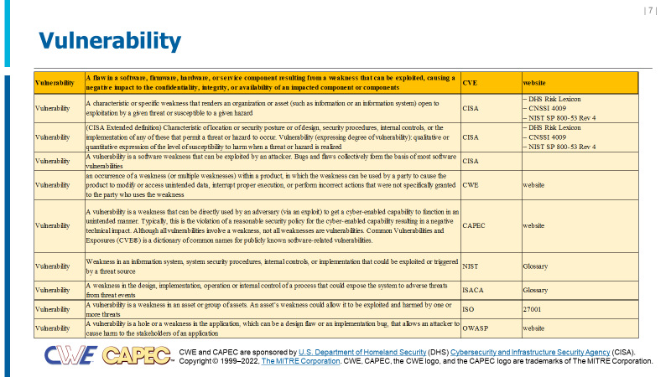
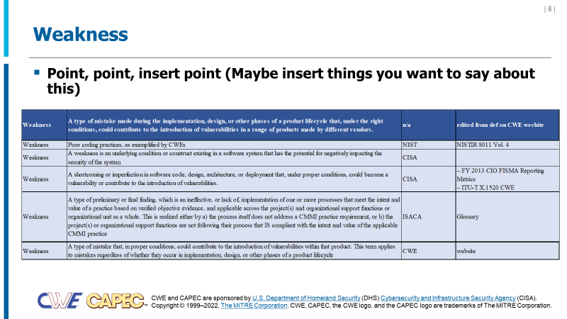
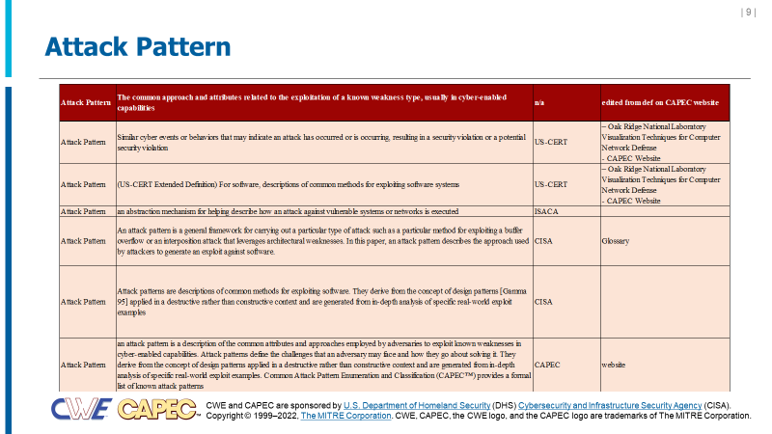
CWE / CAPEC Terminology
Authoritative sources for cybersecurity terminology define terms differently – including CWE/CAPEC!
Vulnerability is defined three different ways between CVE, CWE, and CAPEC ☹
Vulnerability, Weakness, and Attack Patterns have multiple definitions across CISA, NIST, ISO Standards, etc.

Slide 7
‘APES’ Test (developed by Steve Christey Coley)
An acceptable definition for "weakness" should, on its surface, exclude the following:
Aspirin. Aspirin bottles and other medication containers that are expected to have child-proof caps and/or anti-tamper mechanisms.
Example: the Chicago Tylenol murders of 1982
Rationale: These have no computing logic in them.
Physical padlocks that are only opened by a physical key or physical combination.
Example: Master Lock Keyed Padlock as used for school lockers, etc. (Model #5KADPF is an example)
Rationale: while related to security, these have no computing logic in them
Extension cord with insufficient strain relief.
Example: OSHA requirements for flexible cords, https://www.osha.gov/electrical/hazards/flexible-cords
Rationale: no computing logic and no security implications
Spelling error in informational message from web application
Example: web form with tip that says "Do not inccccluuuddee dashes when you enter you're phone number”
Rationale: no security implications
Counter-argument: "sometimes spelling errors have security implications."

Slide 8
Current State (shared w/community 7/13)
Vulnerability | A flaw in a software, firmware, hardware, or service component resulting from a weakness that can be exploited, causing a negative impact to the confidentiality, integrity, or availability of an impacted component or components (from CVE®)
Weakness | A type of flaw or defect inserted during a product lifecycle that, under the right conditions, could contribute to the introduction of vulnerabilities in a range of products made by different vendors
Attack Pattern | The common approach and attributes related to the exploitation of a weakness, usually in cyber-enabled capabilities
Key Question: Is a Weakness an exploitable element?

Slide 9
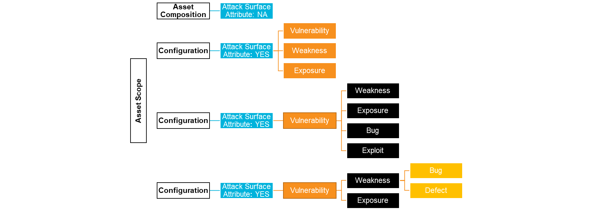
Big Picture Consensus
Conceptual examples of an attack surface based on the feedback
Three general schools of thought
Definition of vulnerability
A flaw in a software, firmware, hardware, or service component resulting from a weakness that can be exploited, causing a negative impact to the confidentiality, integrity, or availability of an impacted component or components (from CVE®)
1
OR
2
OR
3

Slide 10
Big Picture Consensus
Conceptual examples of an attack surface based on the feedback
Three general schools of thought
Definition of vulnerability
A flaw in a software, firmware, hardware, or service component resulting from a weakness that can be exploited, causing a negative impact to the confidentiality, integrity, or availability of an impacted component or components (from CVE®)
1
OR
2
OR
3

Slide 11
Big Picture Consensus
Conceptual examples of an attack surface based on the feedback
Three general schools of thought
Definition of vulnerability
A flaw in a software, firmware, hardware, or service component resulting from a weakness that can be exploited, causing a negative impact to the confidentiality, integrity, or availability of an impacted component or components (from CVE®)
1
OR
Asset Scope
Configuration
Asset Composition
Attack Surface Attribute: NA
Attack Surface Attribute: YES
Vulnerability
Weakness
Exposure
Configuration
Attack Surface Attribute: YES
Vulnerability
Weakness
Exposure
Bug
Exploit
Configuration
Attack Surface Attribute: YES
Vulnerability
Weakness
Bug
Defect
Exposure
2
OR
3

Slide 12
Other Considerations
An “exploit” vs something that is “exploitable”
Conditions are important
A type of condition or mistake made during the implementation, design, or other phases of a product lifecycle could contribute to the introduction of vulnerabilities or other exploitable element in a range of products made by different vendors.

Slide 13
Proposed Definitions
TBD based on feedback in this session
Should we consider “attack surface attributes” within definition of attack pattern?
Term | Definition | Authority | Authorities Doc
Vulnerability | A flaw in a software, firmware, hardware, or service component resulting from a weakness that can be exploited, causing a negative impact to the confidentiality, integrity, or availability of an impacted component or components | CVE | website
Weakness |  | n/a | edited from def on CWE website
Attack Pattern | The common approach and attributes related to the exploitation of a known weakness type, usually in cyber-enabled capabilities | n/a | edited from def on CAPEC website

Slide 14
Topic
Continuing the Discussion: User Personas and CWE/CAPEC Presentation Filters
Alec Summers
CWE/CAPEC Deputy Project Lead

Slide 15
Personas: Finalizing
Formally define each user persona
Share with CWE/CAPEC Board
Once finalized, make public on our sites
Use that as a catalyst for modernizing presentation according to persona needs
“Development lifecycle”
Those who build, use, and protect infrastructure around information systems
Educators: Teachers, professors, or certification programs that educate developers and system designers how to develop more secure code, design more secure products, and/or how to find vulnerabilities.
Technical Writers: Those who communicate advanced technical concepts as clearly, accurately, and comprehensively as possible to their intended audience (e.g., code analysis tool users or system designers)
Tool Developers: Developers of code scanning products, services, and other types of automated techniques for finding weaknesses and attacking systems, and reporting/educating on findings to users
Security Researchers/Analysts: Those who look for ways to attack a product by finding weaknesses using manual and/or automated techniques, then reporting the findings to the vendor and/or the general public (to include threat modeling, C-SCRM)
Incident Response Teams: Those responsible for preparation and reaction to any security event ??

Slide 16
Adjusting our Presentation Filters
“Two-Types” Proposal by Premyslaw Roguski (Red Hat)
Theoretical: users who are more focused on the theoretical aspects of the weaknesses
Educators (teachers, professors, solution architects who design the systems' requirements)
Technical Writers (people responsible for security content, security blogs and articles)
Project and Program Managers who need some level of understanding about security and weaknesses
Technical: users who are managing the security issues and need more details about the nature of the weakness and how to prevent this from happening
Tool Developers, Security Researchers, Pentesters, Incident Response Analysts
(existing) Mapping-Friendly: users who…
(existing) Complete:

Slide 17
Proposed Data Elements for Each Group
Theoretical:
Description, Extended Description, Alternate Terms, Common Consequences
Technical:
Description, Extended Description, Alternate Terms, Modes of Introduction, Demonstrative Examples, Observed Examples, Potential Mitigations, Relationships
Mapping-Friendly:
Description, Extended Description, Alternate Terms, Modes of Introduction, Likelihood of Exploitation, Memberships, Notes
Complete:
all

Slide 18
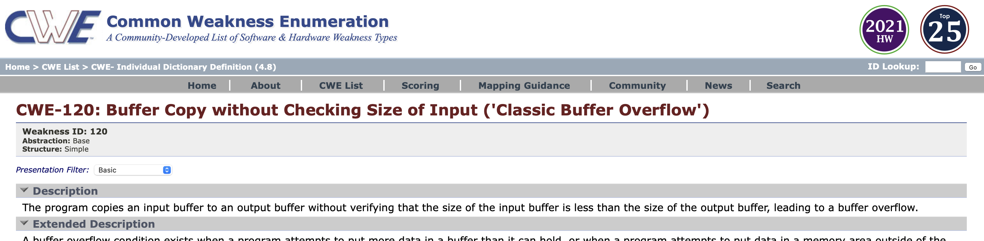
How Can we Improve Presentation Filter Awareness?
Do people know it’s there on each entry?
Where else could we draw attention to it (e.g., landing page, how-to/guidance material?)

Slide 19
Next Meeting – August 24 @ 12pm
PLEASE CONTACT WITH ANY QUESTIONS OR THOUGHTS
CWE@MITRE.ORG
CAPEC@MITRE.ORG

Slide 20
Use Case Scenarios → Content Presentation
CAPEC Existing functionality to filter content detail
Basic, High-level, Mapping-friendly, Complete
CWE Content Filter
BASIC | HIGH-LEVEL | MAPPING | COMPLETE
Description | Description | Description | Description
Applicable_Platforms | View_Audience | View_Audience | View_Audience
Common_Consequences | Alternate_Terms | Alternate_Terms | Alternate_Terms
Likelihood_of_Exploit | Time_of_Introduction | Terminology_Notes | Terminology_Notes
Demonstrative_Examples | Common_Consequences | Relationships | Applicable_Platforms
Potential_Mitigations | Relationships | Relationship_Notes | Modes_of_Introduction
Relationships | Content_History | Theoretical_Notes | Common_Consequences
Content_History |  | Related_Attack_Patterns | Likelihood_of_Exploit
 |  | Content_History | Enabling_Factors_for_Exploitation
 |  |  | Detection_Methods
and more…

Slide 21
Use Case Scenarios → Content Presentation
CAPEC Existing functionality to filter content detail
Basic, Complete
CAPEC CONTENT
BASIC | COMPLETE
Description | Description
Relationships | Relationships
Memberships | Memberships
Execution_Flow | Execution_Flow
Prerequisites | Prerequisites
Mitigations | Mitigations
Related_Weaknesses | Likelihood_Of_Attack
 | Alternate_Terms
 | Typical_Severity
 | Skills_Required
 | Resources_Required
 | Indicators
 | Consequences
 | Example_Instances
 | Related_Weaknesses
 | Taxonomy_Mappings
 | References
 | Notes
 | Content_History

